Slide 1


Weekly Report NTUA 13/12/2019
George Bakas

Slide 2
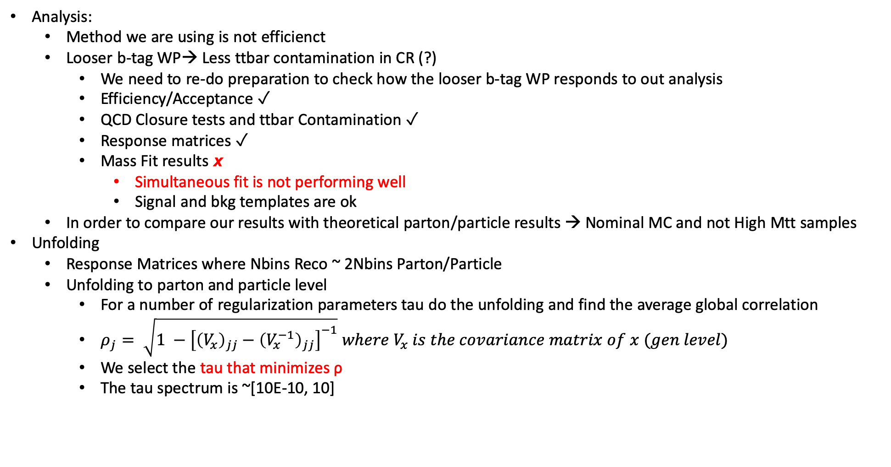
Status Report
Analysis:
Method we are using is not efficienct
Looser b-tag WP→ Less ttbar contamination in CR (?)
We need to re-do preparation to check how the looser b-tag WP responds to out analysis
Efficiency/Acceptance ✓
QCD Closure tests and ttbar Contamination ✓
Response matrices ✓
Mass Fit results 𝙭
Simultaneous fit is not performing well
Signal and bkg templates are ok
In order to compare our results with theoretical parton/particle results → Nominal MC and not High Mtt samples
Unfolding
Response Matrices where Nbins Reco ~ 2Nbins Parton/Particle
Unfolding to parton and particle level
For a number of regularization parameters tau do the unfolding and find the average global correlation
$ρ_{j}= \sqrt{1 −{\left[{\left(V_{x}\right)}_{jj}−{\left(V_{x}^{−1}\right)}_{jj}\right]}^{−1}} where V_{x} is the covariance matrix of x (gen level)$
We select the tau that minimizes ρ
The tau spectrum is ~[10E-10, 10]

Slide 3
TT contamination with Loose b-tagging WP
2016
2017
2018

Slide 4
TT contamination with Loose b-tagging WP
2016
2017
2018

Slide 5
TT contamination with Loose b-tagging WP
2016
2017
2018

Slide 6
QCD Closure tests with Loose b-tagging WP
2016
2017
2018

Slide 7
QCD Closure tests with Loose b-tagging WP
2016
2017
2018

Slide 8
Efficiency And Acceptance for all years

Slide 9
Signal Extraction
Measured dist from data
QCD shape taken from Data (CR)
$$S\left(x_{reco}\right)=D\left(x_{reco}\right)−N_{QCD, reduced}^{(2)}C_{QCD}^{shape}\left(x_{reco}\right)Q\left(x_{reco}\right)−B(x_{reco})$$
Fiducial Yield
Mass Fit in 2btag region
QCD shape correction factor
Subdominant bkg shape and contribution (MC)
Where x_{reco} is the respected variable of interest (ttbar mass,pt, rapidity, leading and subleading jetPt and |jetY|)
We deploy a simultaneous fit in 3 regions (0,1,2 btag) because we do not have a pure Control Region.
Our data CR is ttbar contaminated
$$D{\left(m^{t}\right)}^{(i)}=N_{tt}^{(i)}T^{(i)}\left(m^{t},k_{MassScale}, k_{MassResolution}\right)+N_{bkg}^{(i)}B\left(m^{t} \right)\left(1+k_{1}x\right)+N_{sub}^{(i)}O^{(i)}\left(m^{t}\right)$$
We assume that $N_{tt}^{(0)}={\left(1−e_{b}\right)}^{2}N_{tt}, N_{tt}^{(2)}=e_{b}^{2}N_{tt} and N_{tt}^{(1)}=2\left(1−e_{b}\right)e_{b}N_{tt}$ where e_{b} is the b tagging efficiency and N_{tt} is the total ttbar yield.

Slide 10
Template Fit Results for 2016
Ttbar templates
Subdominant bkg templates

Slide 11
Fit Result
Floating Parameter FinalValue +/- Error
-------------------- --------------------------
kMassResol 1.0522e+00 +/- 3.99e-02
kMassScale 9.9932e-01 +/- 2.13e-03
kQCD_2b -2.2221e-03 +/- 8.40e-04
nFitBkg_2b 2.6836e+03 +/- 5.94e+02
nFitQCD_2b 2.2612e+04 +/- 6.91e+02
nFitSig2b 1.2392e+04 +/- 7.16e+02
qcd_b0 1.2781e+00 +/- 1.59e+00
qcd_b1 3.1374e-02 +/- 1.60e-01
qcd_b2 5.8115e-01 +/- 7.09e-01
qcd_b3 4.9877e-05 +/- 1.32e+00
qcd_b4 3.2530e-01 +/- 4.61e-01
qcd_f1 1.8593e-01 +/- 1.13e-01
qcd_mean 1.5516e+02 +/- 4.94e+00
qcd_sigma 4.7968e+01 +/- 2.82e+00

